Slide 1

SUPERMARKET ANALYSIS PRESENTATION
BY: BLESSING OMOSEBI
COMMUNITY 29
1st of March 2024

Slide 2
TABLE OF CONTENTS
Introduction
Project Overview
Research Questions
Brief processes you took (methodology)
Result findings
Conclusions
Recommendations

Slide 3
INTRODUCTION
This report aims to present the findings and insights gained from analyzing a supermarket sales dataset using Excel. The project's objective was to explore various dimensions of the dataset, including customer types, branch locations, product categories, and payment modes. By meticulously cleaning the data and employing Excel's visualization tools, this analysis aimed to uncover patterns, trends, and key insights that could inform strategic decision-making for the supermarket. Throughout the presentation, we will delve into the key findings, highlighting significant observations and their implications for future strategies. Let's begin our journey into the world of supermarket sales analysis.

Slide 4
PROJECT OVERVIEW
This project involved analyzing a supermarket sales dataset using Excel to extract insights for strategic decision-making. Steps included meticulous data cleaning and visualization using Excel's tools. Special thanks to Justinah Raphael-ojo for a helpful tutorial, and to TheData Initiative for support. The findings, from peak sales months to top-selling products, will guide future strategies. This presentation will delve into these insights, illuminating key aspects of sales performance. Let's explore the world of supermarket sales analysis together.

Slide 5
RESEARCH QUESTIONS
"What factors influence sales performance in supermarkets, and how can data analysis using Excel inform strategic decision-making to optimize sales and enhance business growth?“
"How do customer demographics, branch locations, product categories, and payment methods affect supermarket sales, and what actionable insights can be derived from analyzing these factors using Excel?"

Slide 6
METHODOLOGY
1. Data Acquisition: Obtain the supermarket sales dataset from Kaggle.com, ensuring it includes comprehensive information on customer demographics, branch locations, product categories, and payment methods.
2. Data Cleaning : Thoroughly clean the dataset to ensure accuracy and reliability. This involves identifying and addressing inconsistencies, errors, and duplicates using Excel's data manipulation functions.
3. Exploratory Data Analysis (EDA): Conduct exploratory data analysis to gain initial insights into the dataset's characteristics and distributions. Utilize Excel's pivot tables, descriptive statistics, and charts to examine patterns and trends.
4. Visualization: Create visualizations such as bar charts, column charts, line charts, doughnut charts, and pie charts using Excel to represent the relationships and trends discovered during EDA effectively.

Slide 7
5. Statistical Analysis: Apply statistical techniques, if applicable, to explore relationships between variables, such as correlation analysis or regression analysis, to identify significant factors influencing sales performance.
6. *Interpretation of Findings: Analyze the insights obtained from the data analysis, considering the impact of customer demographics, branch locations, product categories, and payment methods on supermarket sales.
7. Conclusion and Recommendations: Summarize the key findings and provide actionable recommendations for strategic decision-making based on the insights derived from the analysis. Highlight potential areas for improvement and opportunities for growth in the supermarket business.
8. Documentation: Document the entire methodology, including data cleaning procedures, analysis techniques employed, and interpretation of results, to ensure transparency and replicability of the study.

Slide 8
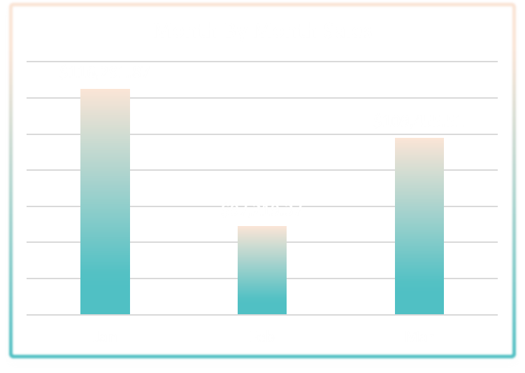
KEY FINDINGS
Sales Performance by Month: The analysis revealed that January witnessed the highest monthly sales, totaling $116k. This insight suggests potential seasonal trends that could inform inventory management and marketing strategies.

Slide 9
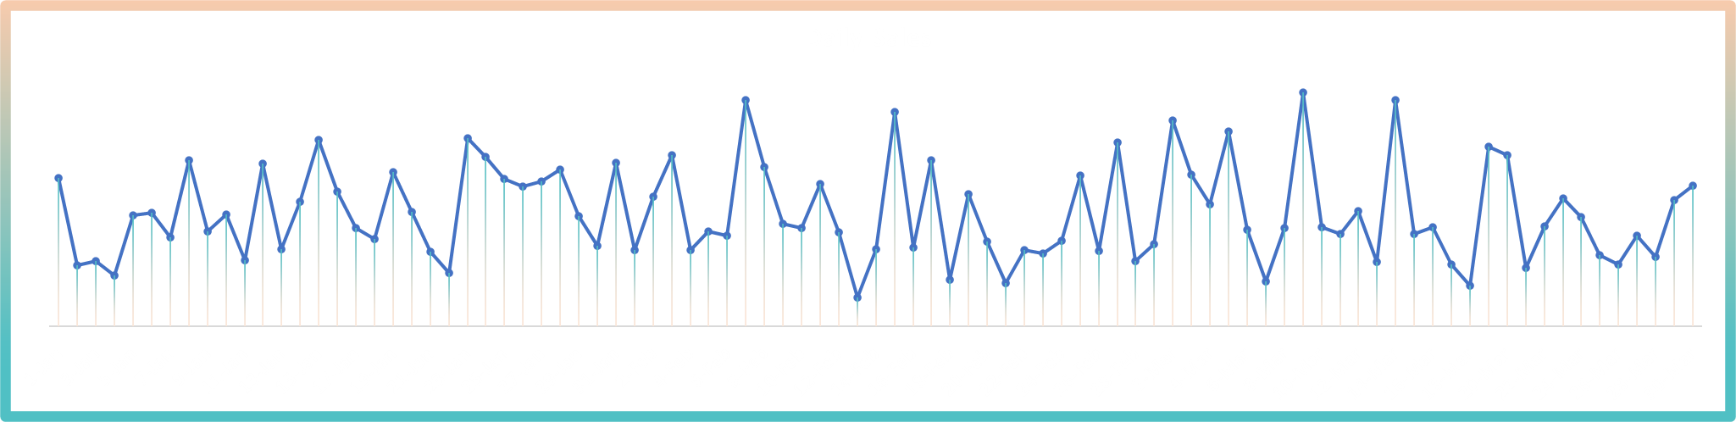
KEY FINDINGS
Daily Sales Fluctuations: Sales were found to fluctuate on a daily basis, with certain days exhibiting higher sales volumes than others. Understanding these fluctuations can aid in staffing optimization and promotional planning.

Slide 10
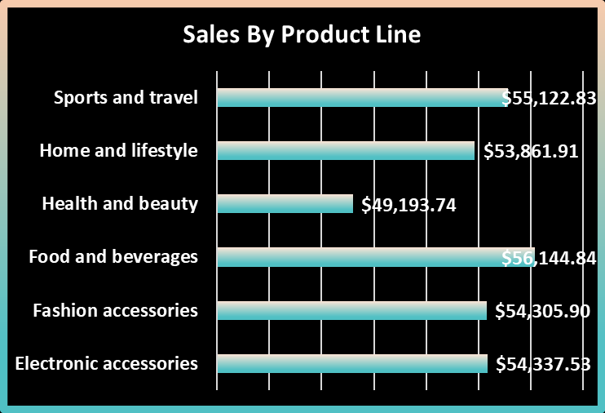
KEY FINDINGS
Top Selling Product Categories: The data highlighted food & beverages as the top-selling product category, generating over $56k in revenue. This indicates a strong demand for these items and suggests opportunities for targeted marketing campaigns and product promotions.

Slide 11
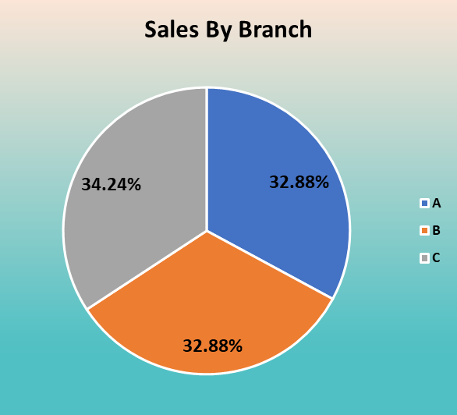
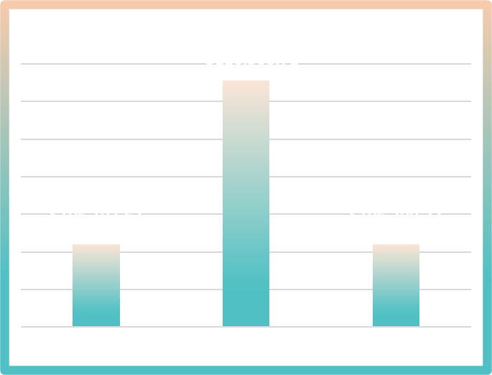
Branch Location Performance: Geographically, the Naypyita city and Branch C outlet showed the highest sales activity, generating over $110k and accounting for 34% of total sales, respectively. This insight can guide decisions related to store expansion, resource allocation, and market targeting..
KEY FINDINGS

Slide 12
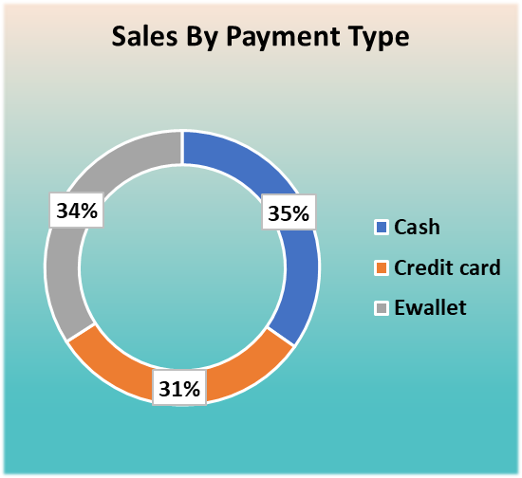
KEY FINDINGS
Preferred Payment Methods: Analysis of payment types revealed a higher adoption of e-wallets, indicating a preference for digital payment convenience among customers. This finding underscores the importance of offering diverse payment options to cater to customer preferences and enhance convenience...

Slide 13
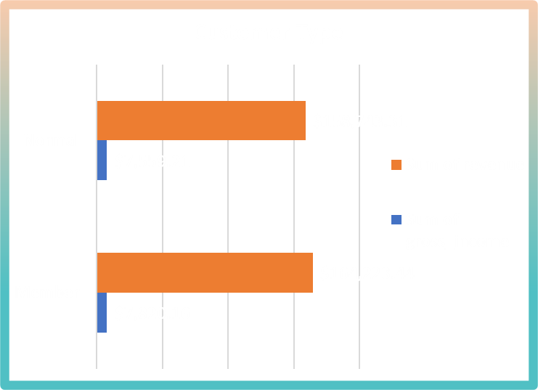
KEY FINDINGS
Customer Segmentation Insights: Member accounts were found to contribute slightly higher sales and revenue compared to regular customers. Further segmentation analysis could uncover differences in purchasing behavior and preferences among customer segments, enabling more targeted marketing strategies.

Slide 14
CONCLUSIONS
Overall, these findings provide valuable insights into key drivers of supermarket sales performance, including seasonal trends, product preferences, geographical variations, and payment behaviors. Leveraging these insights can inform strategic decision-making processes aimed at optimizing sales, enhancing customer experiences, and driving business growth.

Slide 15
RECOMMENDATIONS
The analysis of the supermarket sales dataset yielded valuable insights that can inform strategic decision-making to optimize sales and enhance business growth. Key findings include seasonal sales trends with January as the peak month, strong demand for food & beverages, geographical variations in sales performance, and a growing preference for digital payment methods. Further segmentation analysis identified differences in sales contribution between member accounts and regular customers, highlighting opportunities for personalized marketing strategies.
To leverage these insights effectively, recommendations include implementing targeted marketing campaigns aligned with seasonal trends, optimizing product assortments based on customer preferences, tailoring strategies to specific geographical regions, integrating digital payment options, and implementing customer segmentation strategies to enhance engagement and loyalty.
By adopting these recommendations, the supermarket can enhance sales performance, improve customer satisfaction, and maintain competitiveness in the market. Continuous monitoring and analysis of sales data will be crucial to adapt strategies in response to changing consumer behaviors and market dynamics.

Slide 16

THANK YOU

